Slide 1

Rossmann Store Sales
Analysis
Multivariate
Modeling
Final Project
Danlei Qian
April 20，2020

Slide 2
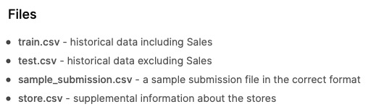
Date Source
Kaggle:
https://www.kaggle.com/c/rossmann-store-sales/discussion
Historical sales data for
1,115 Rossmann stores.

Slide 3
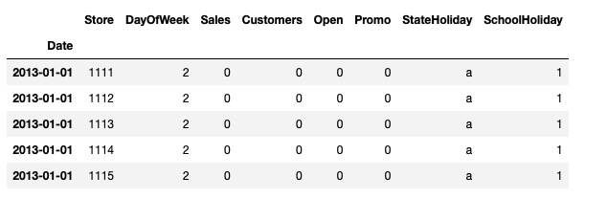
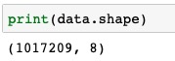
Date Preview
Dependent variable:
Sales - the turnover for any given day (this is what you are predicting)
Independent variable:
Store - a unique Id for each store
Customers - the number of customers on a given day
DayOfWeek - Monday=1,Tuesday=2...
Open - an indicator for whether the store was open: 0 = closed, 1 = open
Promo - indicates whether a store is running a promo on that day
StateHoliday - indicates a state holiday. Normally all stores, with few exceptions, are closed on state holidays. Note that all schools are closed on public holidays and weekends. a = public holiday, b = Easter holiday, c = Christmas, 0 = None
SchoolHoliday - indicates if the (Store, Date) was affected by the closure of public schools

Slide 4
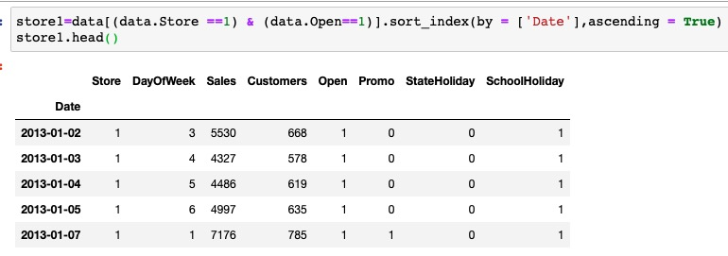
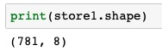
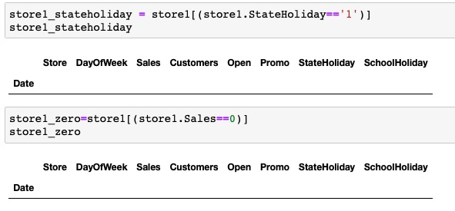
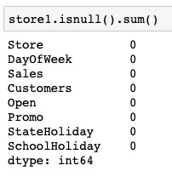
Data Preprocessing
Store 1
Remove open=0
Check Na
Drop StateHoliday
Check Sales=0

Slide 5
Exploratory Data Analysis
Correlation
Customers
Sales
multicollinearity
Promotion

Slide 6
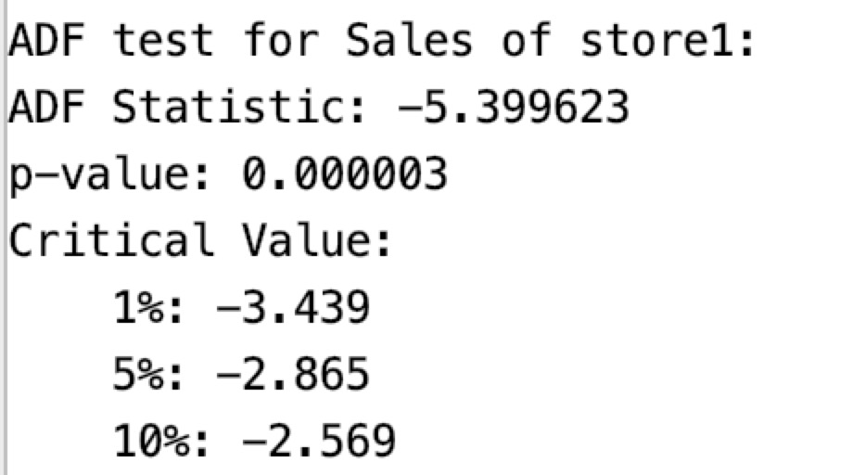
Exploratory Data Analysis
Stationarity

Slide 7
Exploratory Data Analysis
Time series Decomposition

Slide 8
Modeling
Holt-Winters method

Slide 9
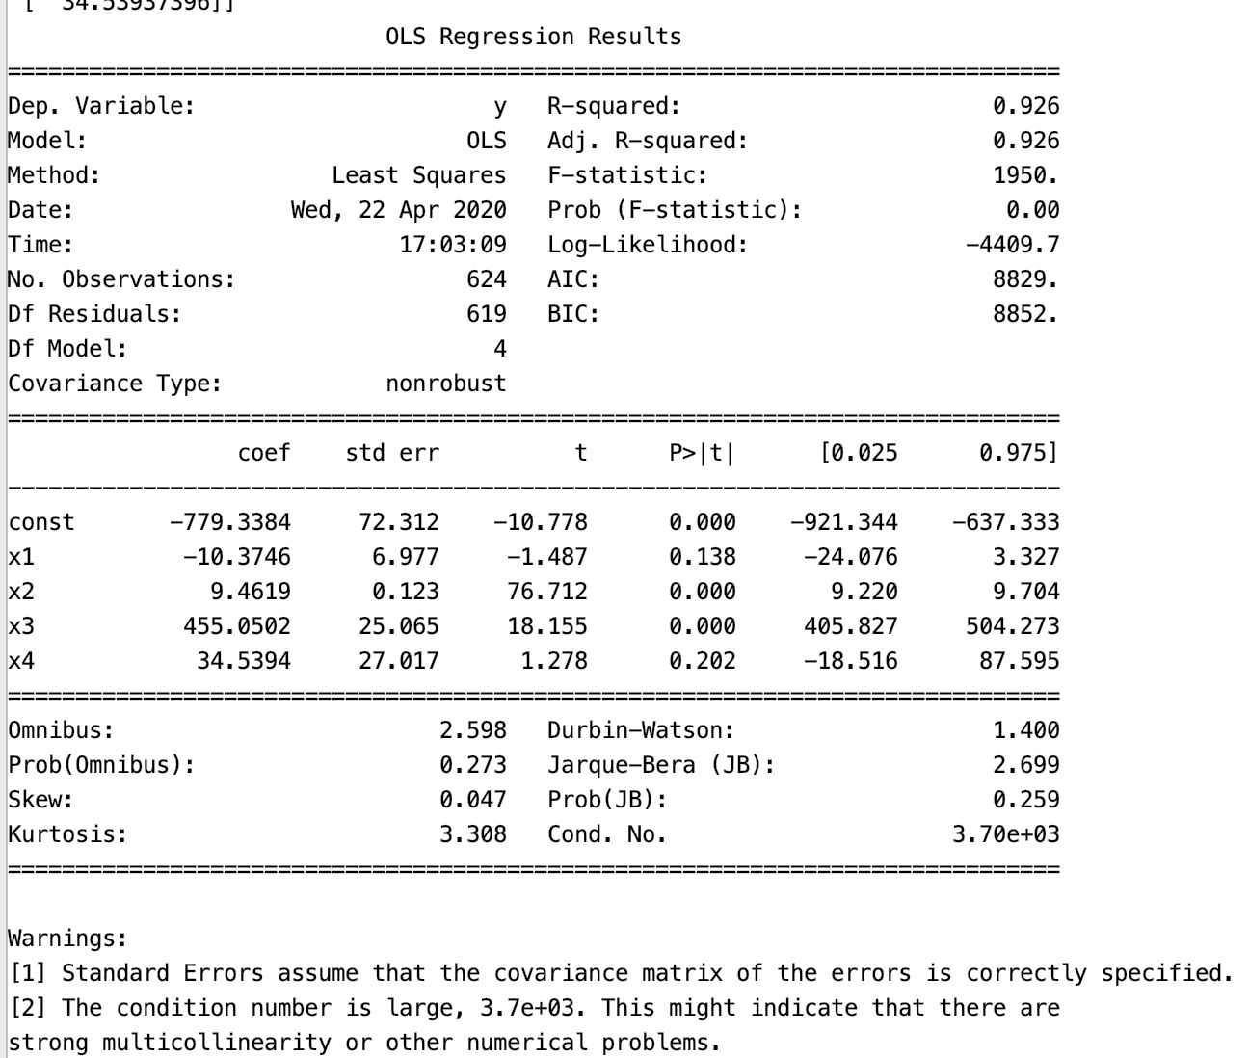
Modeling
Multiple linear regression method
Sales = -779.3384
– 10.3746 *DayOfWeek
+ 9.4619* Customers
+ 455.0502* Promo
+34.5394 * SchoolHoliday
X1 ( DayOfWeek)
X4 (SchoolHoliday)

Slide 10
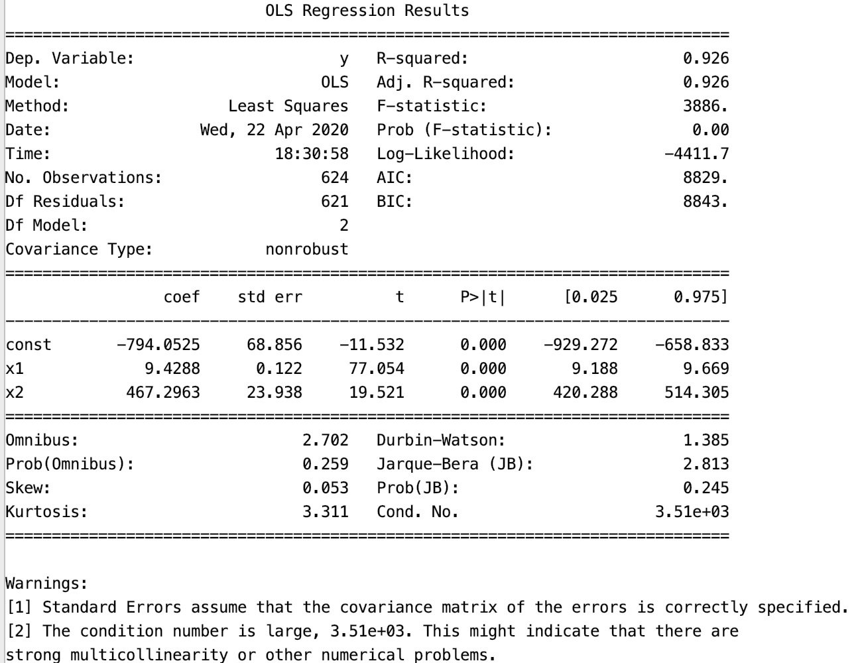
Modeling
Multiple linear regression
Sales = -779.3384
+9.4288* Customers
+ 467.2963* Promo

Slide 11
Modeling
Multiple linear regression

Slide 12
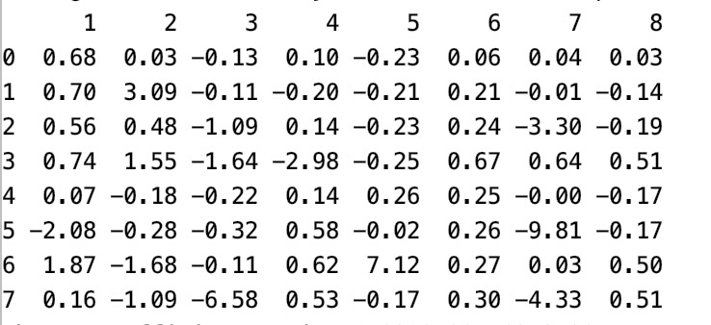
Modeling
ARMA model
GPAC Table

Slide 13
Modeling
ARMA(3,2)

Slide 14
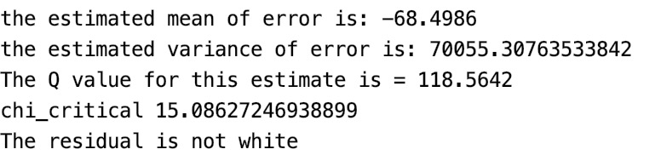
Modeling
ARMA(3,2)
Some information left in residuals

Slide 15
Modeling
ARMA(1,1)

Slide 16
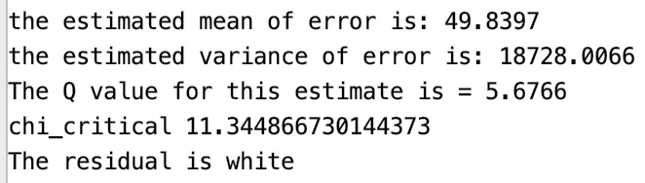
Modeling
ARMA(1,1)
Less information left in residuals
Only when Lag<=5

Slide 17
Conclusions and Limitations
Conclusions
ARMA(1,1) is the best model relatively.
 | Mean of errors | Variance of errors | MSE | RMSE | MAPE
Holt-Winters method | 721.6277 | 1984371.4182 | 2505118.0101 | 1582.7565 | 0.2944
Multiple linear regression | -126.5149 | 69036.4002 | 85042.4161 | 291.6203 | 0.0508
ARMA(3,2) | -68.4986 | 70055.3076 | 74747.3687 | 273.3997 | 0.0540
ARMA(1,1) | 49.8397 | 18728.0066 | 21211.9981 | 145.6434 | 0.0239
Limitation
The data is not enough, cannot remove the seasonality.
Do not solve the multicollinearity, further research: principal components analysis, stepwise regression…

Slide 18
Thanks!

